Slide 1
Prediction of Depression, Anxiety and Stress
CMP5101 – Project Preentation
Mert Burak Burabak

Slide 2
About the project
The Taylor Manifest Anxiety Scale was first developed in 1953 to identify individuals who would be good subjects for studies of stress and other related psychological phenomenon. Since then it has been used as a measure of anxiety as general personality trait. Anxiety is a complex psychological construct that includes a multiple of different facets related to extensive worrying that may impair normal functioning. The test has been widely studied and used in research.
In this project, we will use machine learning algorithms to determine the stress levels of participants using the Taylor Manifest Scale test. If we can successfully decompose the stress levels, questions with high discrimination will guide us.

Slide 3
TABLE OF CONTENTS
1
2
3
4
5
6
About the Dataset
Exploratory Data Analysis
Preprocessing
Feature Engineering
Model
Model Results

Slide 4
About the Dataset
https://www.kaggle.com/yamqwe/depression-anxiety-stress-scales
The results of an interactive version of the Taylor Manifest Anxiety Scale (39.975 Participant)
The test consists of fifty statements about you. You must rate each one as true or false. It should take most people four to ten minutes to complete.
The survey was open to anyone and people were motivated to take it to get personalized results. At the end of the test they also were given the option to complete a short research survey. This dataset comes from those who agreed to complete the research survey and answered yes to the question "Have you given accurate answers and may they be used for research?" at the end.
This data was collected 2017 - 2019.

Slide 5
About the Dataset
The following items were included in the survey:
Questions (42):
Each question was presented one at a time in a random order for each new participant along with a 4 point rating scale asking the user to indicate how often that had been true of them in the past week
This response is stored in variable A (e.g. Q1A). Also recorded was the time taken in milliseconds to answer that question (Q1E) and that question's position in the survey (Q1I).
These other durations were also recorded (measured on the server's side):
Introelapse: The time spent on the introduction/landing page (in seconds)
Testelapse: The time spent on all the DASS questions (should be equivalent to the time elapsed on all the indiviudal questions combined)
Surveyelapse: The time spent answering the rest of the demographic and survey questions
Scale: 1 to 4, 1 = Did not apply to me at all, 4 = Applied to me very much, or most of the time

Slide 6
About the Dataset
Q1 I found myself getting upset by quite trivial things.
Q2 I was aware of dryness of my mouth.
Q3 I couldn't seem to experience any positive feeling at all.
Q4 I experienced breathing difficulty (eg, excessively rapid breathing, breathlessness in the absence of physical exertion).
Q5 I just couldn't seem to get going.
Q6 I tended to over-react to situations.
Q7 I had a feeling of shakiness (eg, legs going to give way).
Q8 I found it difficult to relax.
Q9 I found myself in situations that made me so anxious I was most relieved when they ended.
Q10 I felt that I had nothing to look forward to.
.
.
.
Q40 I was worried about situations in which I might panic and make a fool of myself.
Q41 I experienced trembling (eg, in the hands).
Q42 I found it difficult to work up the initiative to do things.

Slide 7
About the Dataset
On the next page was a generic demographics survey with many different questions.
The Ten Item Personality Inventory was administered
TIPI1 Extraverted, enthusiastic.
TIPI2 Critical, quarrelsome.
TIPI3 Dependable, self-disciplined.
TIPI4 Anxious, easily upset.
TIPI5 Open to new experiences, complex.
TIPI6 Reserved, quiet.
TIPI7 Sympathetic, warm.
TIPI8 Disorganized, careless.
TIPI9 Calm, emotionally stable.
TIPI10 Conventional, uncreative.
Scale: 1 to 7, 1 = Disagree strongly, 7 = Agree strongly

Slide 8
About the Dataset
The following items were presented as a check-list and subjects were instructed "In the grid below, check all the words whose definitions you are sure you know":
VCL1 boat
VCL2 incoherent
VCL3 pallid
.
.
.
.
VCL16 funny
A value of 1 is checked, 0 means unchecked. The words at VCL6, VCL9,
and VCL12 are not real words and can be used as a validity check.

Slide 9
About the Dataset
A bunch more questions were then asked:
Education: "How much education have you completed?", 1=Less than high school, 2=High school, 3=University degree, 4=Graduate degree
Urban: "What type of area did you live when you were a child?", 1=Rural (country side), 2=Suburban, 3=Urban (town, city)
Gender: "What is your gender?", 1=Male, 2=Female, 3=Other
Engnat: "Is English your native language?", 1=Yes, 2=No
Age: "How many years old are you?"
Hand: "What hand do you use to write with?", 1=Right, 2=Left, 3=Both
Religion: "What is your religion?", 1=Agnostic, 2=Atheist, 3=Buddhist, 4=Christian (Catholic), 5=Christian (Mormon), 6=Christian (Protestant), 7=Christian (Other), 8=Hindu, 9=Jewish, 10=Muslim, 11=Sikh, 12=Other
Orientation: "What is your sexual orientation?", 1=Heterosexual, 2=Bisexual, 3=Homosexual, 4=Asexual, 5=Other
Race: "What is your race?", 10=Asian, 20=Arab, 30=Black, 40=Indigenous Australian, 50=Native American, 60=White, 70=Other
Voted: "Have you voted in a national election in the past year?", 1=Yes, 2=No
Married: "What is your marital status?", 1=Never married, 2=Currently married, 3=Previously married
Familysize: "Including you, how many children did your mother have?"
Major: "If you attended a university, what was your major (e.g. "psychology", "English", "civil engineering")?"

Slide 10
About the Dataset
The following values were derived from technical information:
Country: ISO country code of where the user connected from
Screensize: 1=device with small screen (phone, etc), 2=device with big screen (laptop, desktop, etc)
Uniquenetworklocation: 1=only one survey from user's specific network in dataset, 2=multiple surveys submitted from the network of this user (2 does not necessarily imply duplicate records for an individual, as it could be different students at a single school or different memebers of the same household; and even if 1 there still could be duplicate records from a single individual e.g. if they took it once on their wifi and once on their phone)
Source: how the user found the test, 1=from the front page of the site hosting the survey, 2=from google, 0=other or unknown

Slide 11
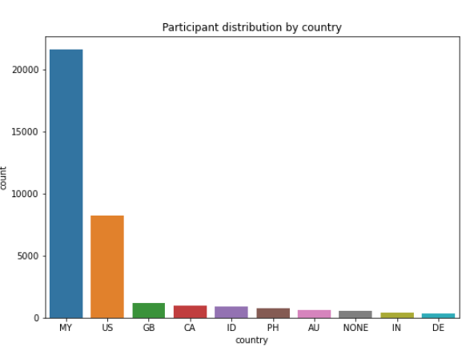
Exploratory Data Analysis
Column Count: 172 Row Count: 39775 Total Null Count: 11405
Column count: 172
Row Count: 39.875
Total Null Count: 11.402

Slide 12
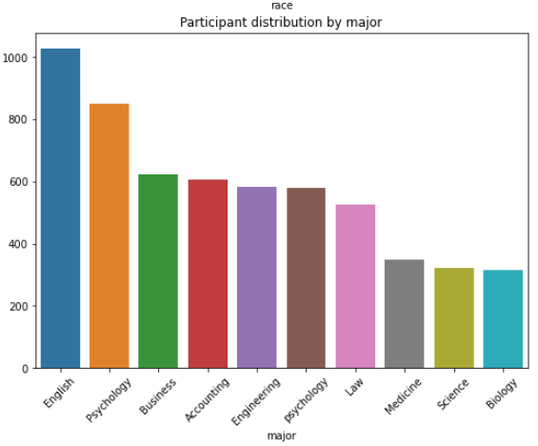
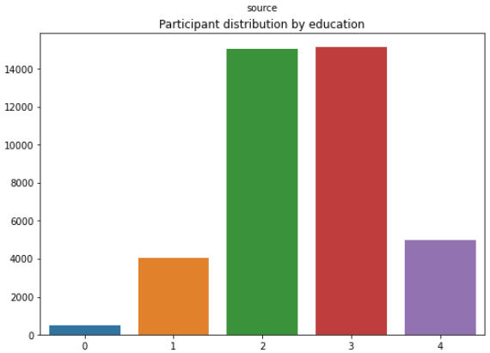
Exploratory Data Analysis
Column Count: 172 Row Count: 39775 Total Null Count: 11405
1=Less than high school, 2=High school, 3=University degree, 4=Graduate degree

Slide 13
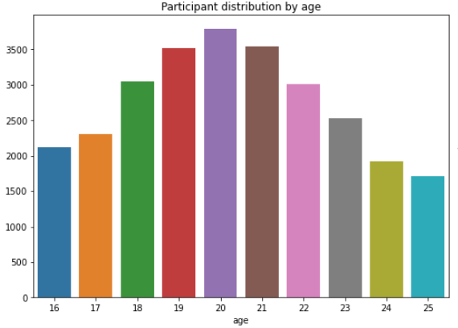
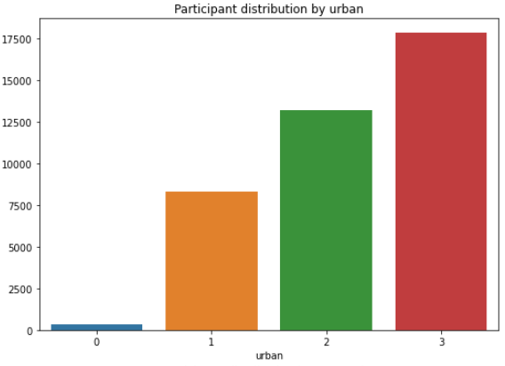
Exploratory Data Analysis
Column Count: 172 Row Count: 39775 Total Null Count: 11405
1=Rural (country side), 2=Suburban, 3=Urban (town, city)

Slide 14
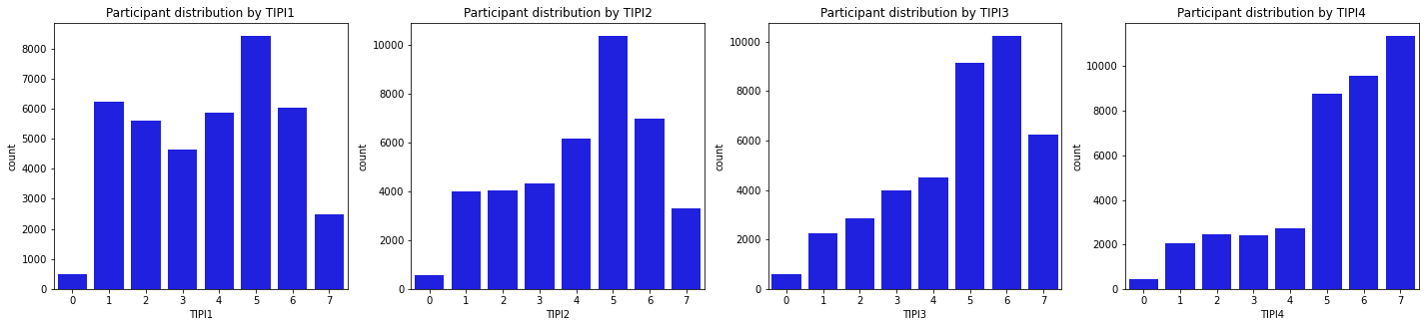
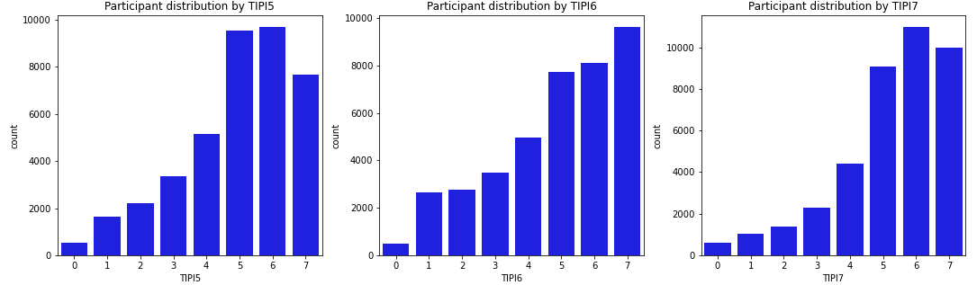
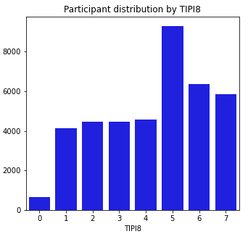
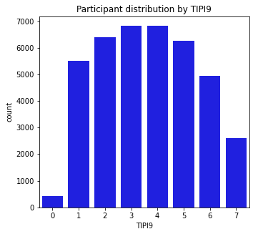
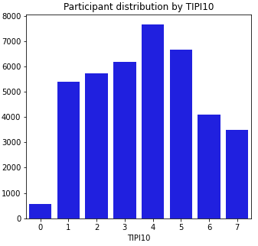
Exploratory Data Analysis
TIPI1 Extraverted, enthusiastic.
TIPI2 Critical, quarrelsome.
TIPI3 Dependable, self-disciplined.
TIPI4 Anxious, easily upset.
TIPI5 Open to new experiences, complex.
TIPI6 Reserved, quiet.
TIPI7 Sympathetic, warm.
TIPI8 Disorganized, careless.
TIPI9 Calm, emotionally stable.
TIPI10 Conventional, uncreative.

Slide 15
Preprocessing
The words at VCL6, VCL9, and VCL12 are not real words and can be used as a validity check.
We will create new feature is_valid. If an answer to the VCL6, VCL9, VCL12 is 1 then survey will not be valid. We will remove invalid surveys.
Result: 86.95% of the surveys are valid.
Handling Missing Values:
Feature «country»: 0.01%
Feature «major»: 27.68%
Feature «country»: fill with the mode.
Feature «major»: fill with the «NaN». (because of the high cardinality.)

Slide 16
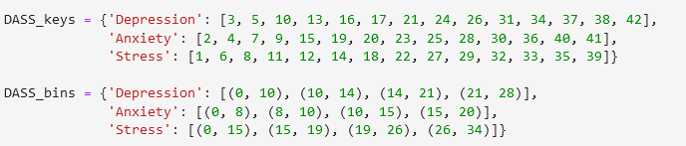
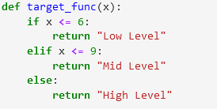

Feature Engineering
Target Feature:
Categorize the question with keys.
Calculate the total score on the categories.
Reference: https://neurocogsystem.com/wp-content/uploads/2021/02/DASS-42-Scoring.pdf
Create the target levels with the sums of 3 dimension (Depression Score, Anxiety Score, Stress Score)

Slide 17
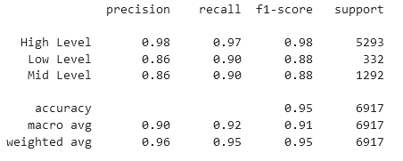
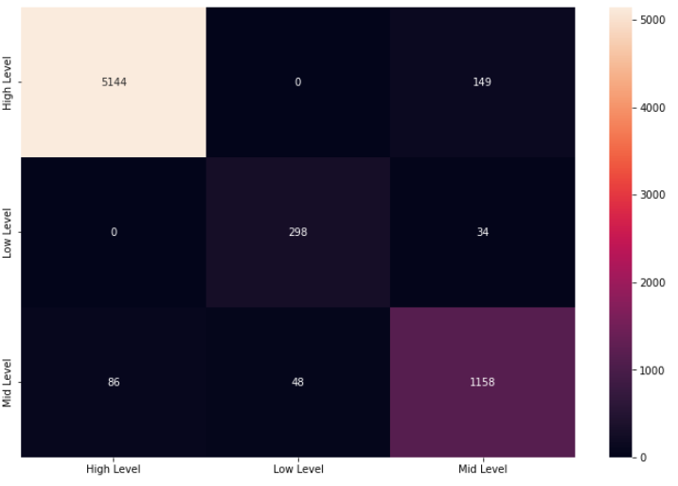
Model
Train Test Split: Test size: 20%(randomly)
Model: XGBClassifier with sample weight
(sample weights are used at imbalanced models. It adjust weights inversely proportional to class frequencies in the input data)
Inputs: Question Answers (Q1A, Q2A, Q3A,...)
Target: Formulated Levels(High Level, Mid Level, Low Level)
Test Results
Confusion Matrix

Slide 18
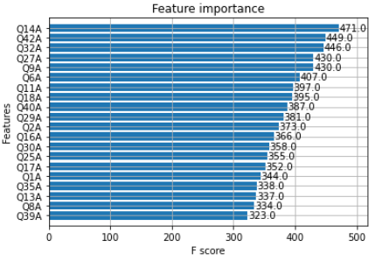
Model Results

Slide 19
Model Results
Most Important Questions(according to the Model):
Q14 I found myself getting impatient when I was delayed in any way (eg, elevators, traffic lights, being kept waiting).
Q42 I found it difficult to work up the initiative to do things.
Q32 I found it difficult to tolerate interruptions to what I was doing.
Q27 I found that I was very irritable.
Q9 I found myself in situations that made me so anxious I was most relieved when they ended.
Q6 I tended to over-react to situations.

